Slide 1
WELCOME

Slide 2
Online Examination system
prepared by : Anup pokhrel

Slide 3
Introduction
Online examination system is a computer system which is used to take exam by using computer
It is a web-based application
It can be conducted through internet and intranet
It can replace a paper-based exam in future

Slide 4
Objectives
Create web-based application which can be used to take online exam
To replace a paper-based examination system
Use MySQL I database server to create secure database for the system

Slide 5
Scope
Online Examination System is designed for educational institutes to conduct logical test.
It is a web-based application so, it can be used from anywhere
Easy to conduct examination
No need of examiner to conduct exam
It saves money and time

Slide 6
Features
Secure
Easy to use
Accurate
Need less human resource
Generate result automatically and quickly

Slide 7
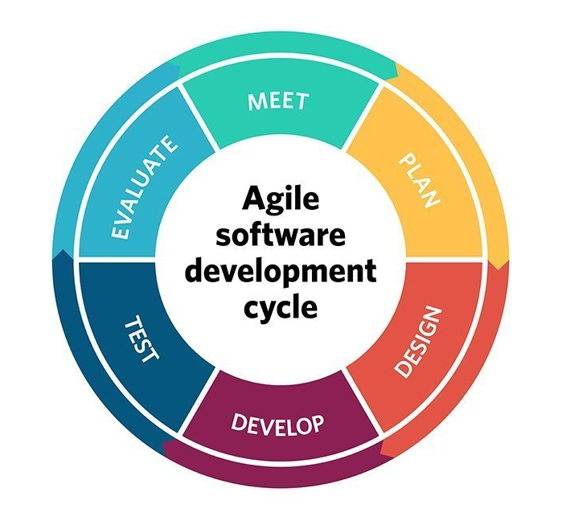
System Development life cycle
Agile Development Methodology

Slide 8
Programming language
PHP (Object oriented programming language)
MySQL
HTML/CSS
JavaScript
Bootstrap

Slide 9
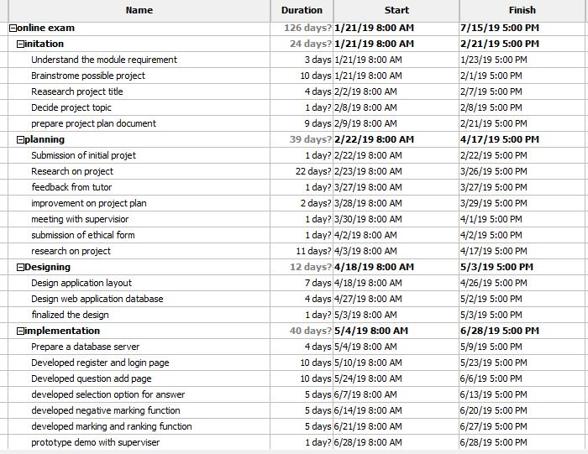
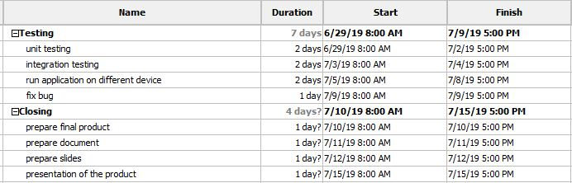
Planning
Gantt chart

Slide 10
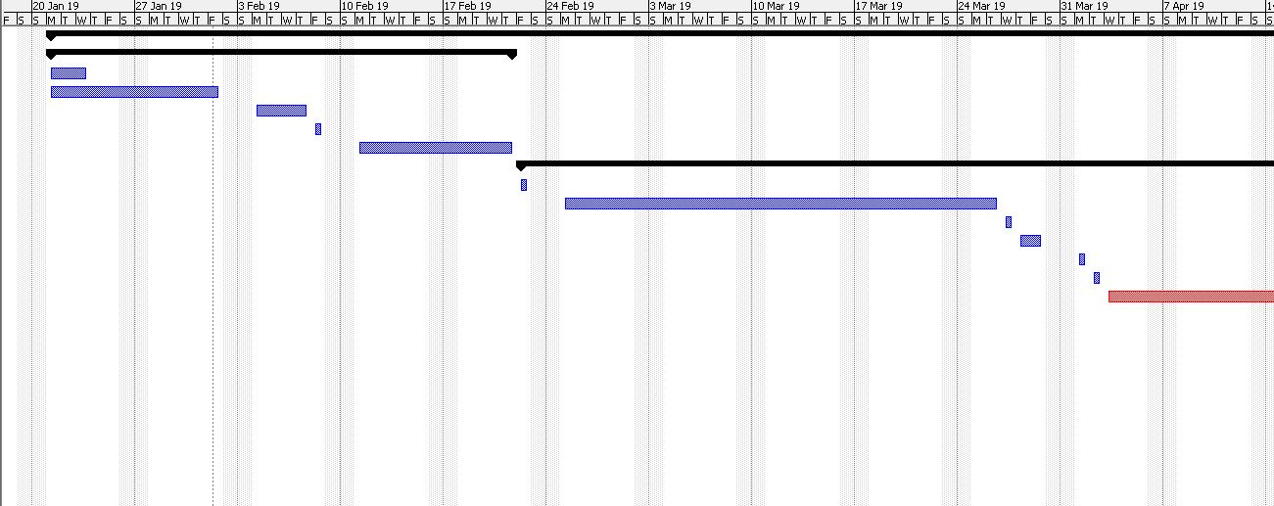
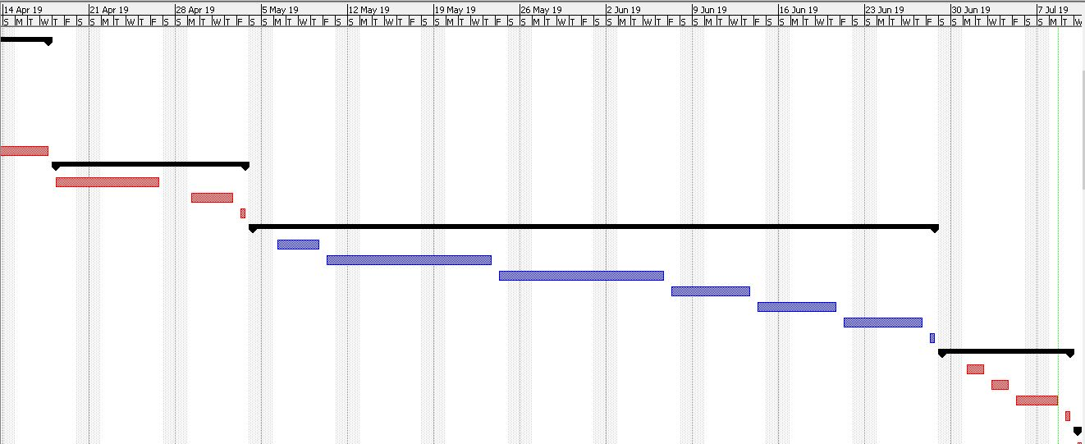
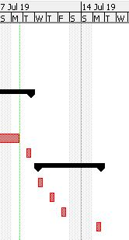
Planning Gantt chart

Slide 11
Design Flowchart Flow chart of Online Examination System

Slide 12
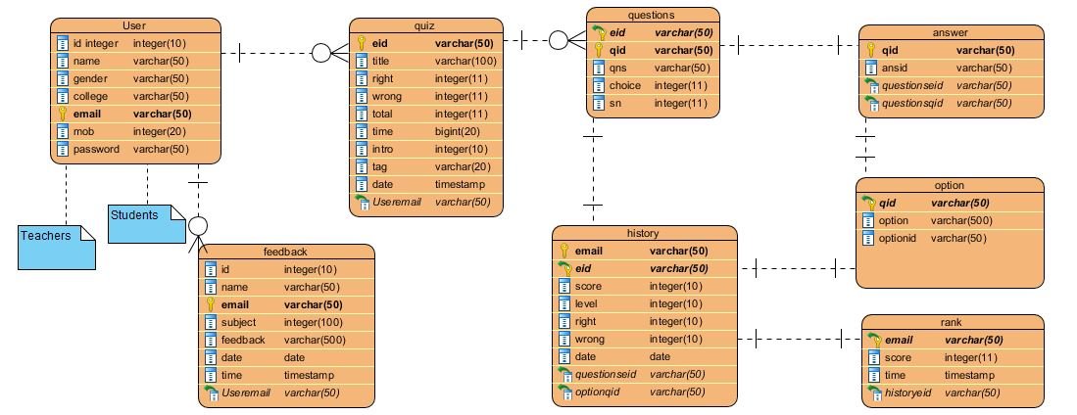
Design Entity relationship diagram

Slide 13
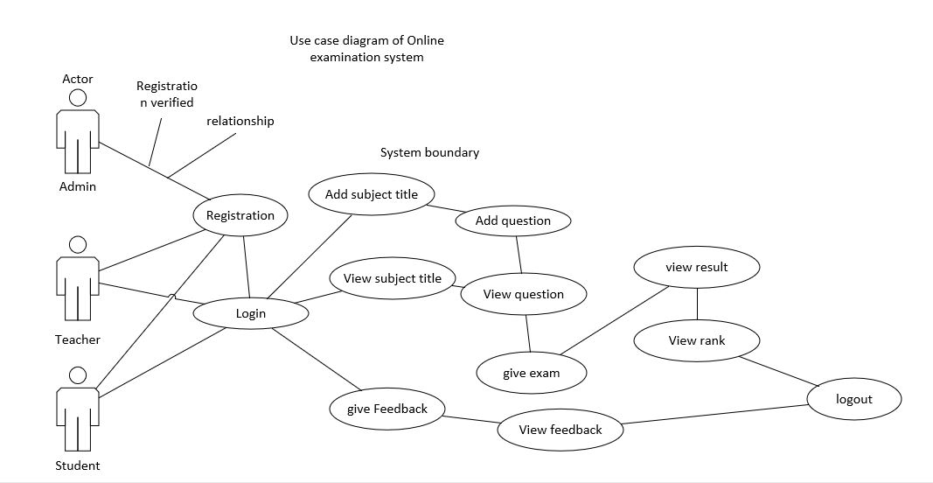
Design Use case diagram

Slide 14
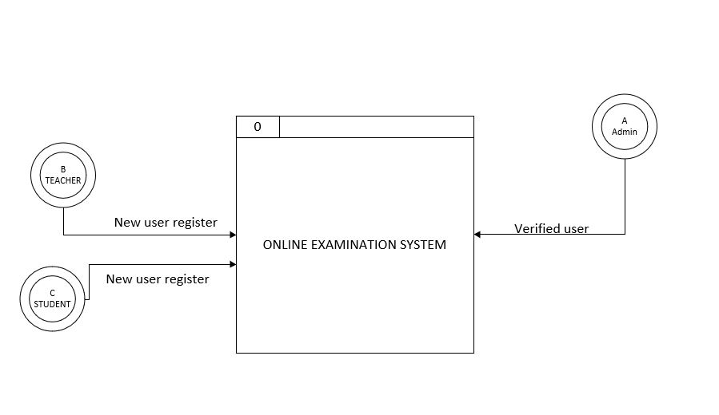
Design Level 0 Data flow diagram

Slide 15
Design Data flow level 1 diagram

Slide 16
Implementation and Testing
White box testing
Need skillful tester.
Checks the internal functionality of the system

Slide 17
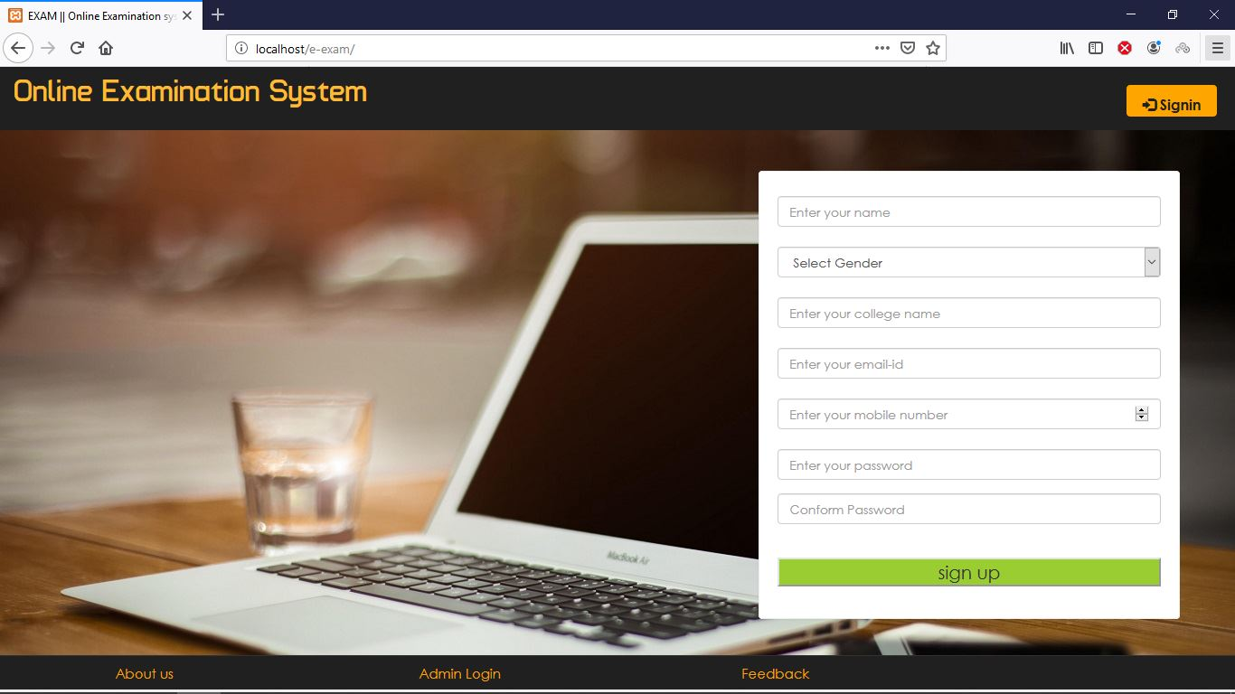
Implementation and testing Home page

Slide 18
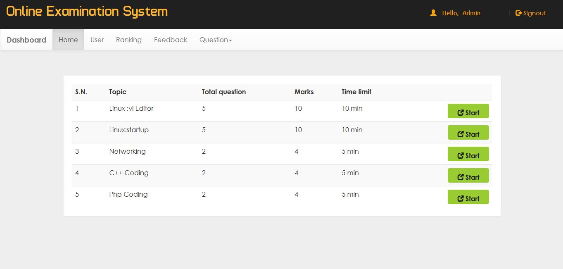
Implementation

Slide 19
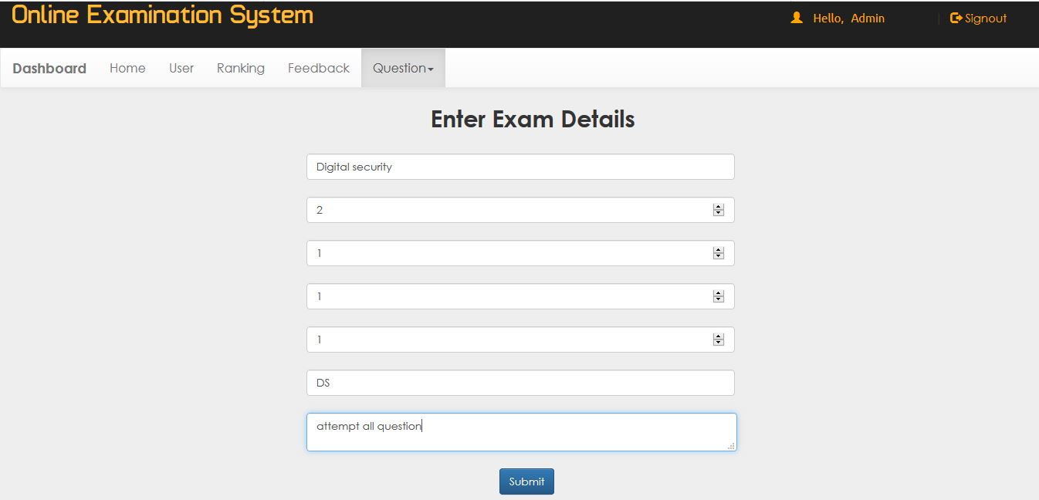
Implementation and testing
Adding Exam Details

Slide 20
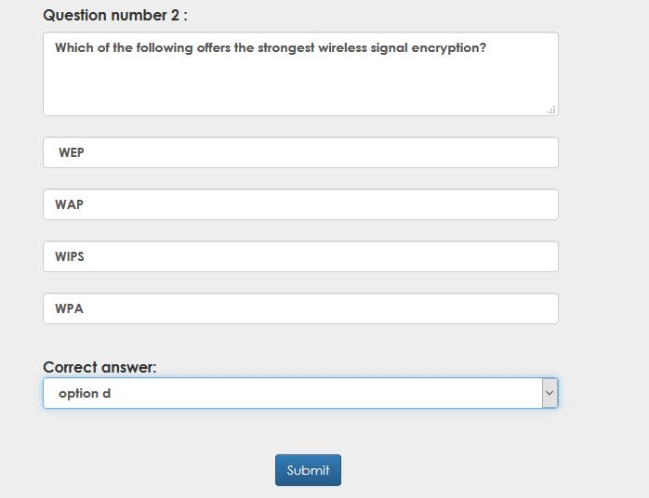
Implementation and Testing
Adding question and answer

Slide 21
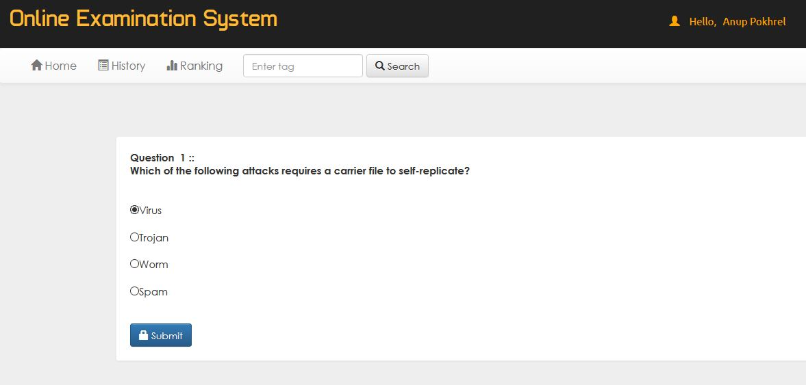
Implementation and Testing
Exam giving by student

Slide 22
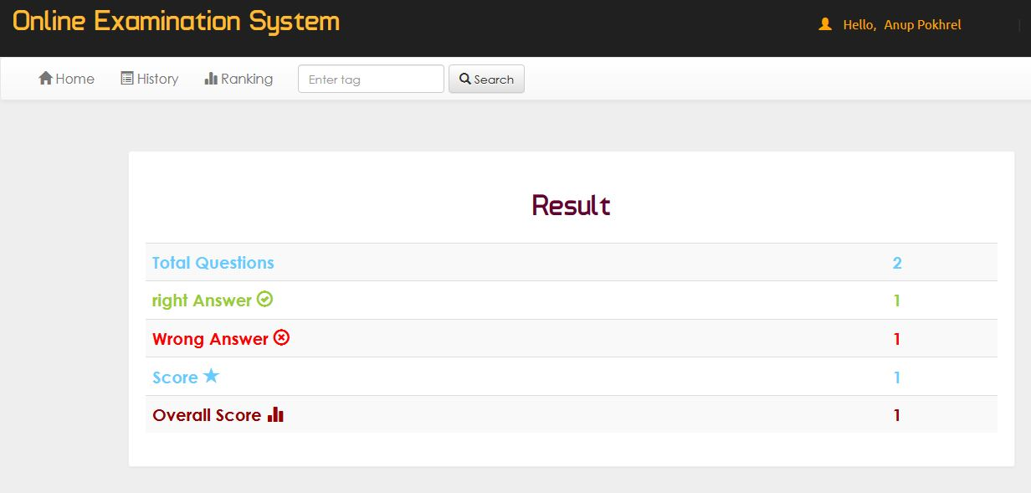
Implementation and Testing
Result of exam

Slide 23
Future work
Update personal details and question
Generate progress report card of student
Generate random question selection and distribution
Add proper search function

Slide 24
Conclusion
This web-application provides facility to conduct online examination form anywhere. It saves time and money as it provide a result immediately . It is automatically generated by the server.

Slide 25
Any question

Slide 26
Thank you

